Slide 1
Modeling Popularity in Programming Languages using ARIMA
Modelling and Simulation (SOFE 4820U)
-
Group 5
Bhavik Panchal (100591777)
Mayar Shaath (100711121)

Slide 2
Problem Description
With the advancement of technology and the growth of the programming/software development industry, there are constant changes to the popularity and use of different programming languages. Thus, education institutions and other training institutes face the drawback of potentially teaching languages no longer desired in the rapidly changing industry. Even hiring companies may face a similar problem when looking for the “perfect” candidate, when they are in fact searching for experience in a practically dead language.

Slide 3






Project Overview
The project aims to model the current trends in programming language popularity and predict the future trends based on the data of the current trends. The models will be used to predict popularity for the 5 most used languages to determine whether they will continue to be a popular choice among programmers. They can also be used to predict the general direction of where the industry is heading as different languages are mainly used for different types of programming.

Slide 4
Proposed Solution
A graphical model showing the change in popularity for different programming languages from 2004-2022, including a future popularity prediction.
This will help to predict the future trend of certain programming languages in order to determine if they are worth learning/practicing as time progresses.

Slide 5
Technical Description of the Solution
ARIMA Model (AutoRegressive Integrated Moving Average)
With this model, we refer to a series of data points indexed in time order as a time series
A time series can be broken down into 3 components:
- Trend : upward and downward movement of the data over a large period of time
- Seasonality : Seasonal Variance
- Noise : Spikes at random intervals

Slide 6
AutoRegressive Integrated Moving Average Model (ARIMA)
Is made up of 2 models, AutoRegressive Model (AR) & Moving Average Model (MA) with differencing added.
Differencing subtracts the current value from the previous and can be used to transform a time series into one that is stationary.
Three integers are used to parametrize ARIMA models.
p : number of autoregressive terms (AR order)
d : number of non seasonal differences (differencing order)
q : number of moving-average terms (MA order)

Slide 7
Dataset
We worked with the programming_languages_dataset.csv that we found on kaggle.
(https://www.kaggle.com/datasets/muhammadkhalid/most-popular-programming-languages-since-2004)
This dataset contains data about 28 popular programming languages from each month during the span of 2004 to 2022. All values of each programming language are shown in percentage form out of 100%.
For the sake of our project, we will focus on 5 Programming languages. (C/C++, Java. JavaScript, PHP & Python)
To work with each individual language, we created a new dataset for each language containing only their own statistics

Slide 8
Stationarity
Before we applied any statistical model on a time series, we wanted to ensure it is stationary. This means , that the mean and the variance should not be a function of time. If a time series is stationary and has a particular behaviour over a given time, then it is safe to assume that it will have a similar behaviour at some later point in time.
There are 2 ways to determine if a time series is stationary:
Rolling Statistics
- Plotting the mean and rolling standard deviation. The time series is stationary if they remain constant with time.
Augmented Dickey-Fuller Test
- The time series is considered stationary if the p-value is low and the critical values at 1%, 5%, and 10% confidence intervals are as close as possible to the adf statistics

Slide 9
There are multiple transformations that can be applied to time series to render it stationary.
Subtracting the rolling mean
Applying exponential decay
Time Shifting
Autocorrelation Plots
Graphically summarize the strength of a relationship with observation in a time series with observations at prior time steps
Calculates the correlation of times series observations with observations with previous time steps (lags)
Is used to determine ‘q’ value
Partial Autocorrelation
Is a summary of the relationship between an observation in a time series with observations at prior time steps with intervening observations removed
Is used to determine the ‘p’ value

Slide 10
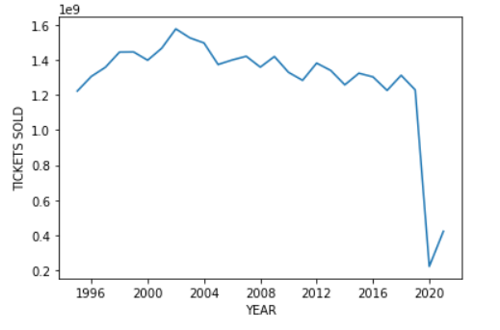
Encountered Difficulties
It was very difficult determining the the p & q values when plotting the MA and the ARIMA
We had to use trial and error to determine these values
When working with the dataset, we had to format certain values properly (month: yyyy - mm - dd)
Initially, we wanted to base our project on Movie ticket sales. We found a dataset for this problem, but the dataset had annual statistics for movie ticket sales from 1995 to 2021. There were 2 problems with this topic:
There was not enough data for us to generate a reasonable future prediction of movie ticket sales (for an ARIMA model, the more data that is provided, will lead to a better prediction of the future
There was a big skew near the end of the original data (due to COVID-19)

Slide 11
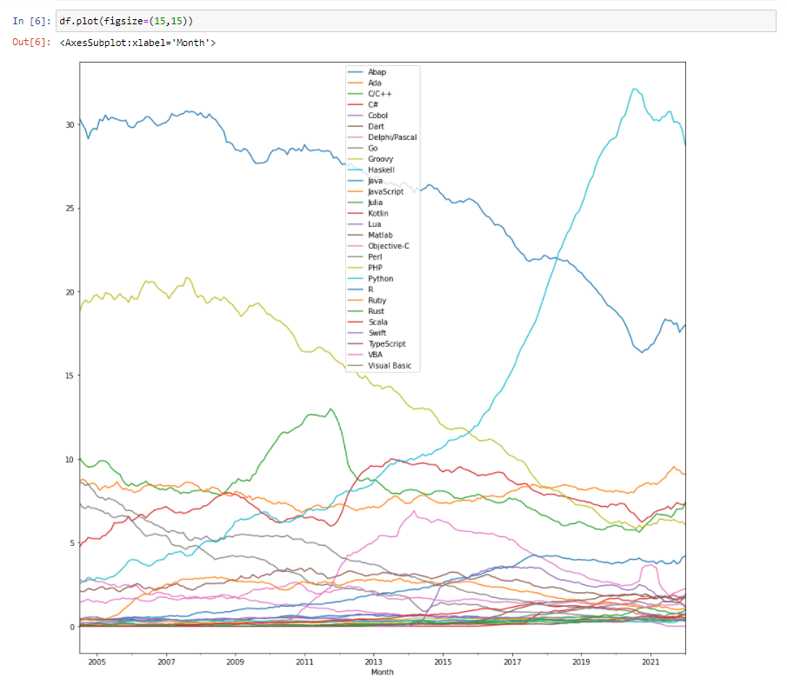
Evaluation

Slide 12
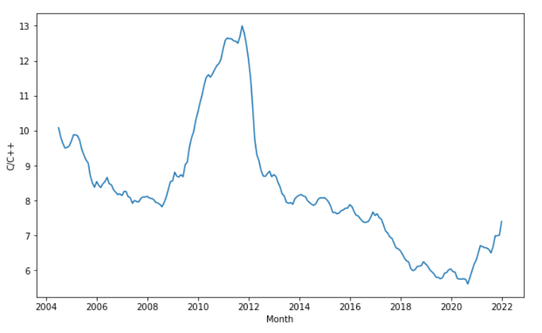
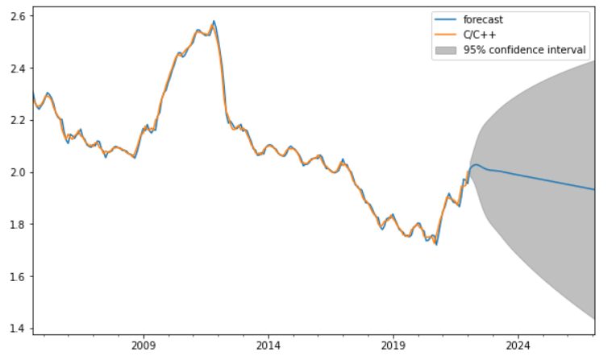
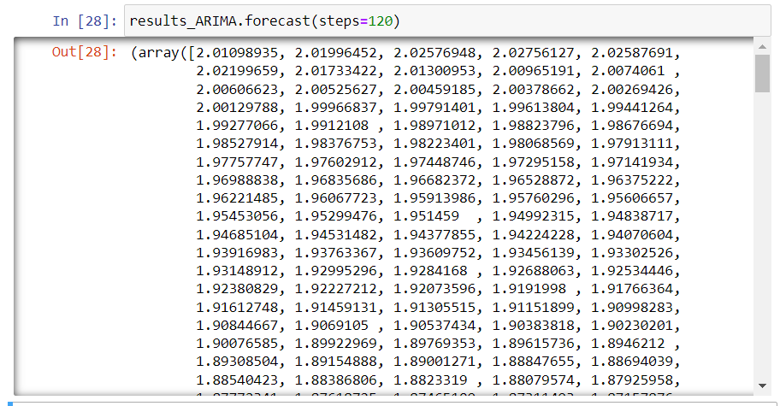
Results - C/C++

Slide 13
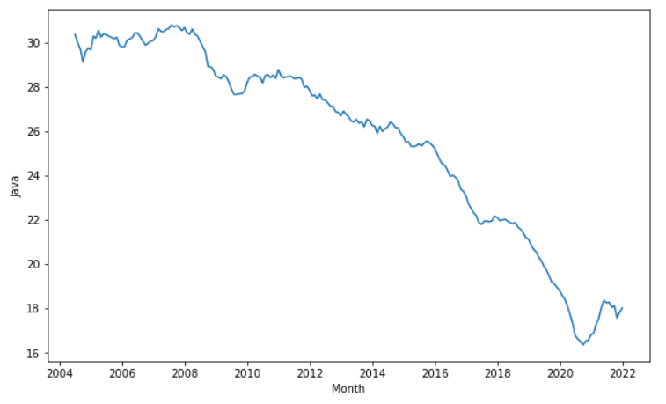
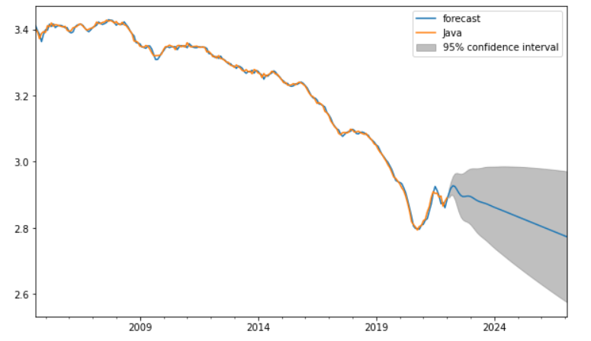
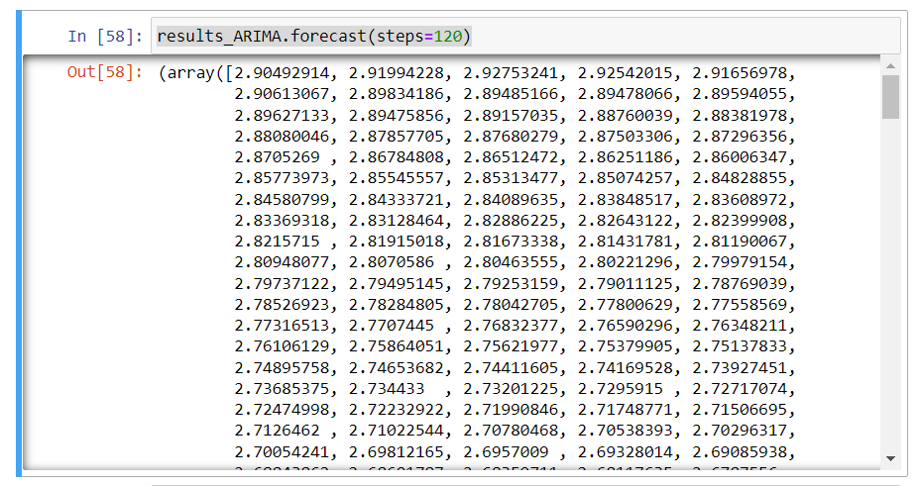
Results - Java

Slide 14
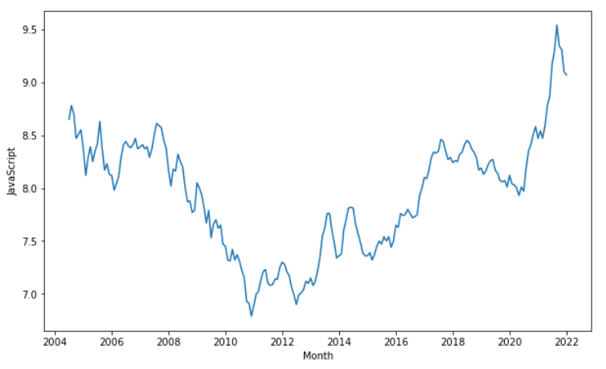
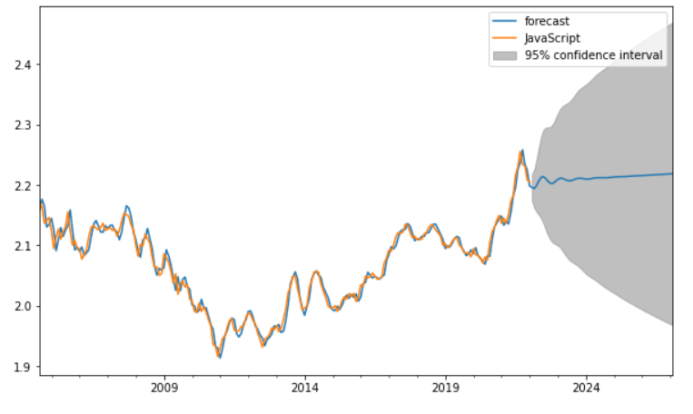
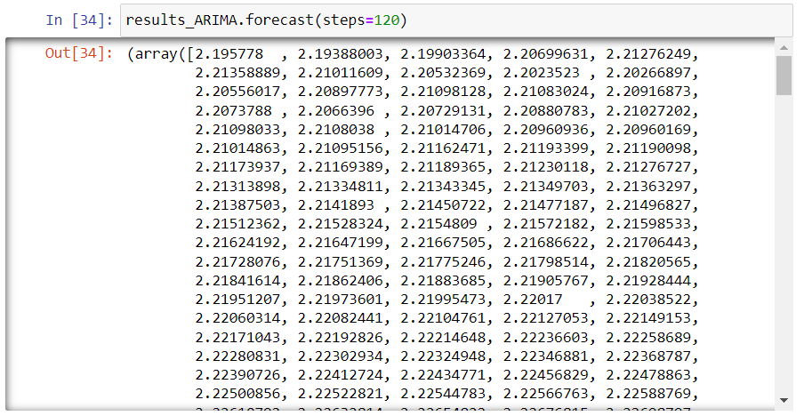
Results - JavaScript

Slide 15
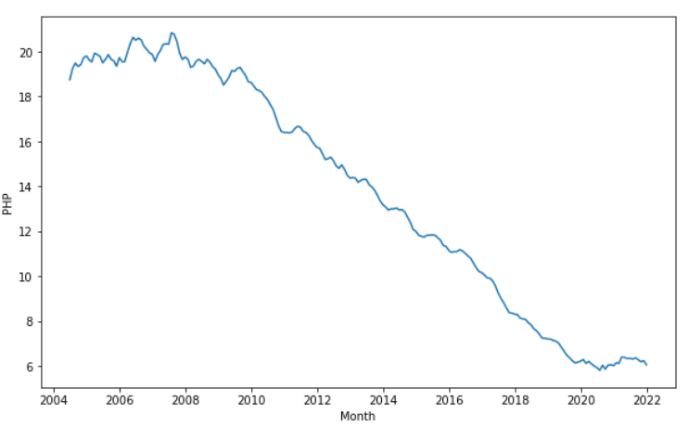
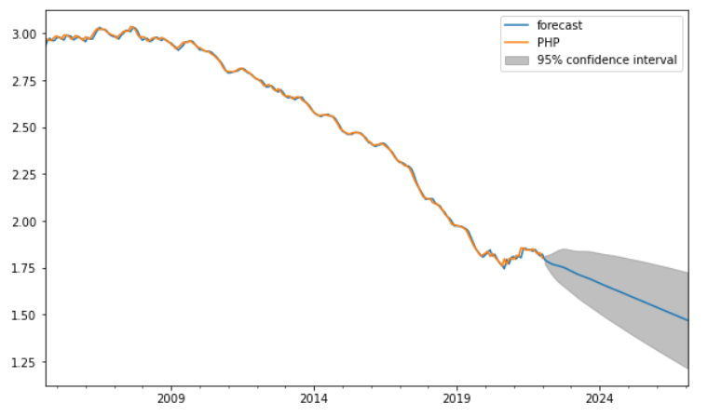
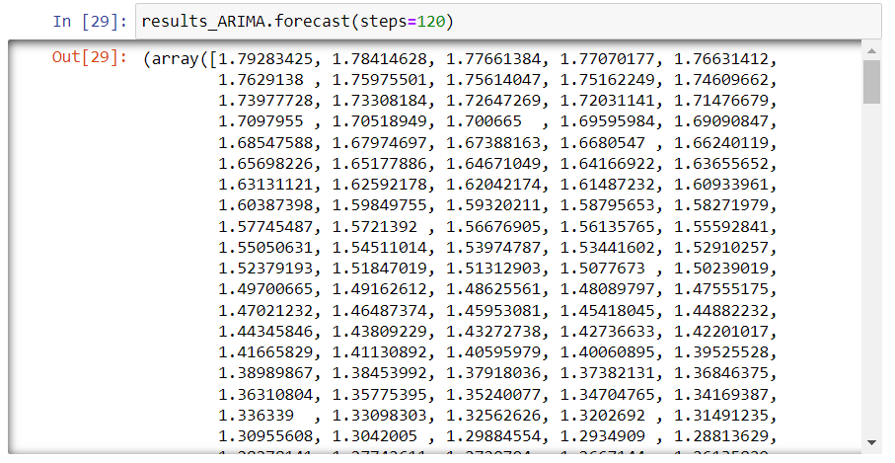
Results - PHP

Slide 16
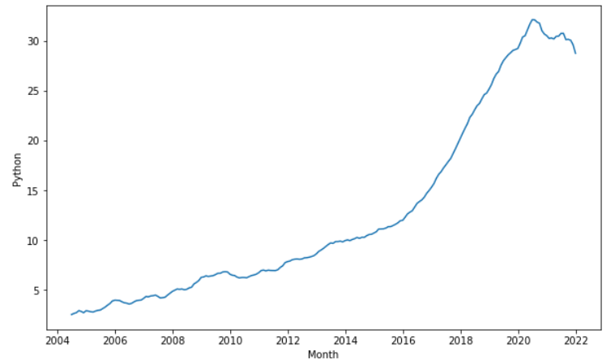
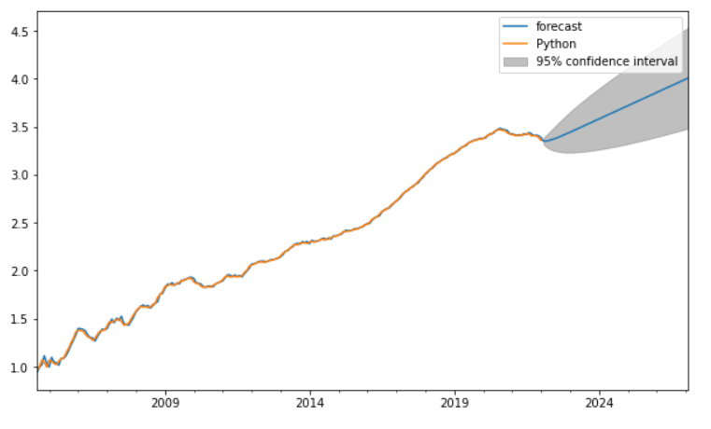
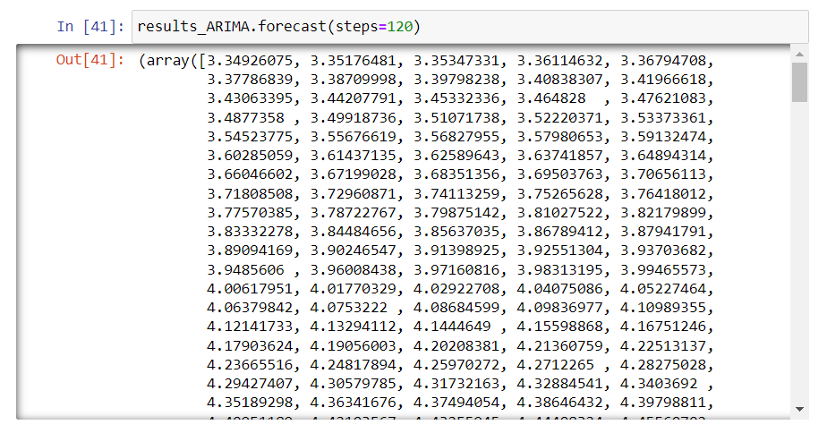
Results - Python

Slide 17
Results - Summary Table
Language | Highest Value % | Lowest Value % | Forecast | Prediction Confidence Level
C/C++ | 13 | 3 | Decrease | Uncertain
Java | 35 | 16 | Decrease | Confident
JavaScript | 9.5 | 6.5 | Slight Increase | Uncertain
PHP | 21 | 5 | Decrease | Confident
Python | 35 | 3 | Increase | Confident

Slide 18
Future Work
We could work with more data
More years of research
Daily statistics rather than monthly
Work with more seasonal data to produce more complex results
Would make predictions of less linear and more seasonal
We could plot reasons as to why certain languages dip or raise in popularity

Slide 19
Conclusion
We were successfully able to model the 5 most popular programming languages in terms of past, present, and future popularity. The results show that C/C++, Java and PHP are 3 languages that are on a downwards trend in terms of popularity. JavaScript looks like it will have a very slight rise in its trend, but it is currently trending downwards which takes away our confidence in its prediction. Python, on the other hand, is showing constant growth in popularity and is expected to continue to do so. This suggests a growing interest in data analysis and visualization as well as machine learning and AI technologies since Python is most commonly used in these fields. It is safe to assume that out of the 5 programming languages observed, Python will be the most popular in the future, possibly making it the most used language in many aspects.

Slide 20
Thank you
Any questions?

